Slide 1
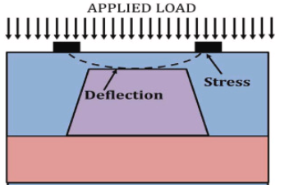
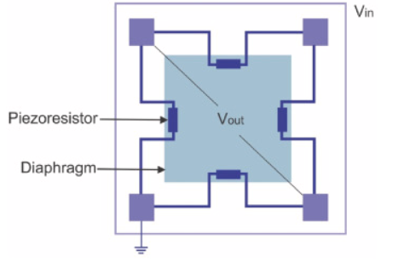


Mexene based Piezoresistive pressure sensor
squared of dimensions (length = 800μm and thickness = 10μm) of silicon membrane
Linearity and high sentivity
The sensor chip, which has a small diaphragm manufactured using bulk silicon micromachining techniques, is the most essential part of the piezoresistive pressure sensor. Four piezoresistors were placed in the stress concentration regions (SCR) to construct a full Wheatstone bridge, which transforms stress to an electrical signal via the piezoresistive effect. The pressure sensor should have high sensitivity and low non-linearity in an attempt to reach the measuring demands of ultra-low pressure.
Add wheatstone bridge for the senor ouput
https://www.sciencedirect.com/science/article/pii/S2665917422001568

Slide 2
Fabrication
Coating of the Mexene on the silicon to make four piezoresistors
See here
2. Wet etching of the silicon to make to make silicon membrane for pressure sensing
https://www.nature.com/articles/s41467-017-01136-9
https://www.parallel-synthesis.com/SiliconMicrofabrication.htm
See here
biomedical applications
MEMS based for biomedical applications with high performance parameters like sensitivity and linearity are required for low pressure range.The low-pressure range (1–5 kPa) is a significant range that comprises intra-body pressures like intracranial pressure (ICP) and intraocular pressure (IOP).
https://www.sciencedirect.com/science/article/pii/S2665917422001568

Slide 3
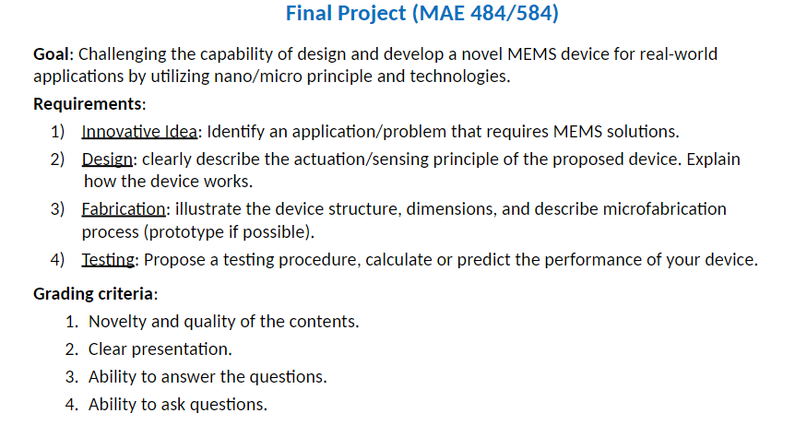
Distribution of work
Emamul did already
Shokuntola
Bindu+harsha
Sheikh

